Slide 1
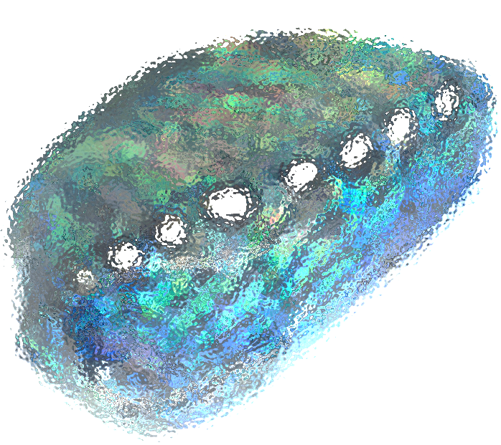
Abalone Project
Leanne Canessa 02/2018
Notes:
Today I’ll be speaking about a small project in progress I’ve been working on between my graduation from the initial CoderGirl study track and now.
Original Image: https://www.shoplc.com/education/gemstone-abalone-shell

Slide 2
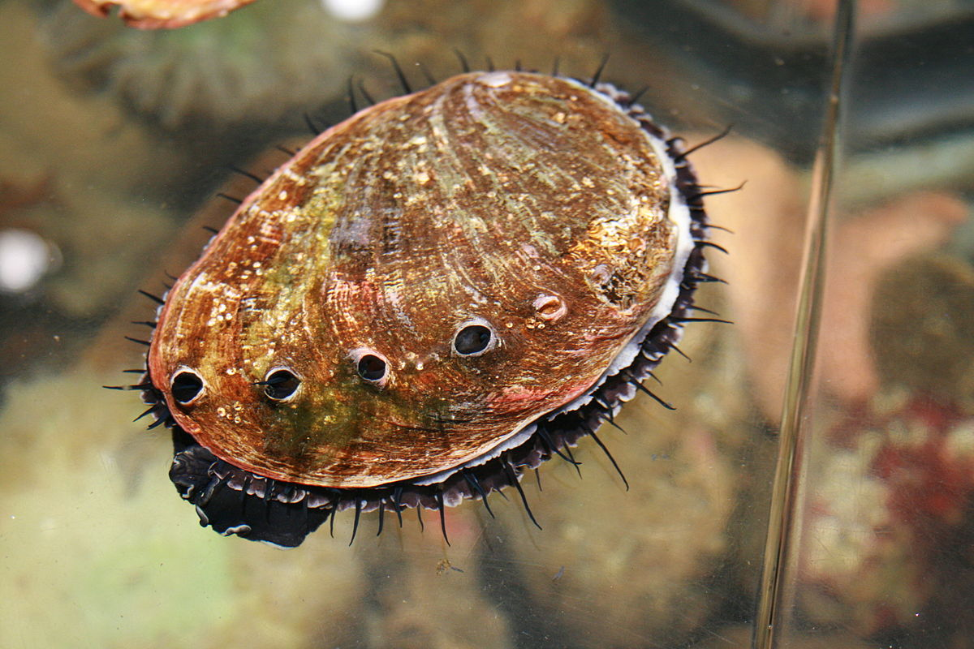
Project Background
Selection Criteria
Time
“simplicity”
Interest
Test skills
Abalone Dataset!
Notes:
When choosing my project I had a few criteria in mind: the timeframe (short); I wanted data to work with ASAP. With my novice skills, I wanted a well defined, relatively “simple” problem concerning a subject that would keep my interest. And I wanted to be able to test and apply the skills I learned over the course of my studies.
The abalone dataset fits all these criteria nicely: readily available on UCI ML Repository, clean data in an area of interest (marine biology), with a well defined goal.
Image originally found on Wikipedia article front page.

Slide 3
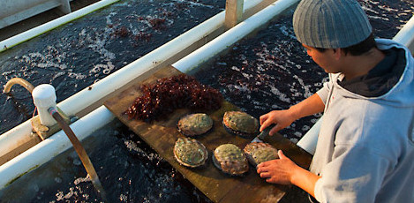
Subject Background
Commercially important
Mollusc in genus Haliotis
Species number
Conservation status
Population study from 1994
Goal: “Given various features, determine age of animal.”
Notes:
Flesh consumed around the world, prepared a variety of ways. Shells are used in crafting.
Between 30 and 130 different species.
Overfishing and climate change a concern, but lots on the market is farmed for “ranched.”
The data is sourced from a population study done off the coast of Tasmania in 1994.
Image source: http://culturedabalone.com/

Slide 4
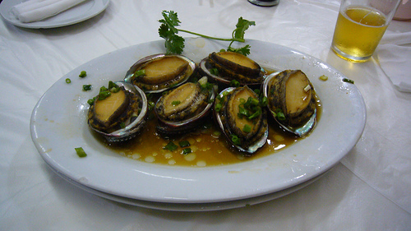
Approach
Domain research, examine data/descriptive statistics
Test approach
Check assumptions
Modify approach
Repeat
Notes:
Try various kinds of models ranging from classification to regression, even though the UCI page describes the data problem as a classification one.
Regularly reexamine assumptions.
Keep going until I have something that works!
Image source: https://en.wikipedia.org/wiki/Abalone#/media/File:Cantoneseabalone.jpg

Slide 5
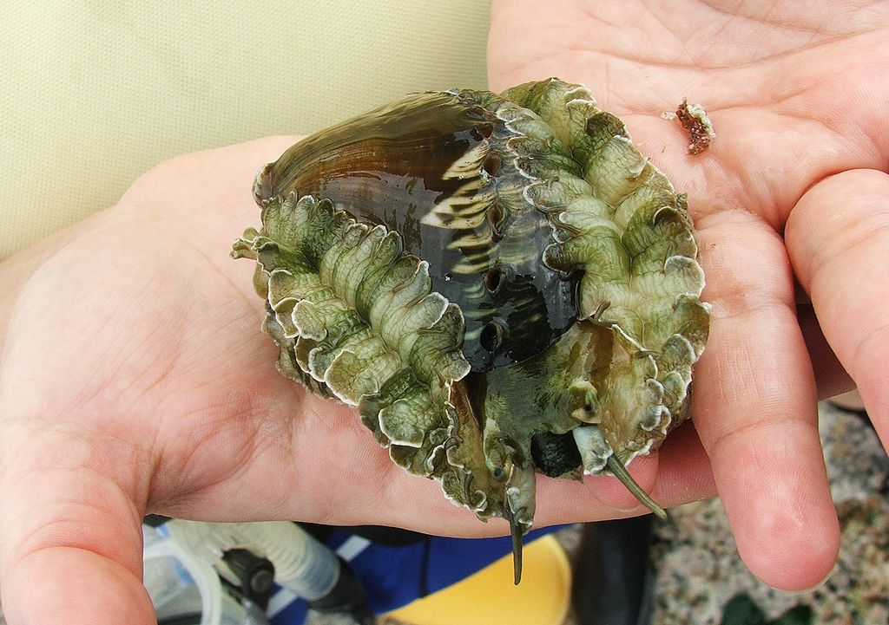
Jupyter time!
Link to GitHub
Notes:
https://en.wikipedia.org/wiki/Abalone#/media/File:Ass%E2%80%99s_ear_abalone_(Haliotis_asinina)_S01.jpg
www.sirrob01.com
“ass’s ear abalone – Haliotis asinina”

